Slide 1

Project Title - Seasonal Agriculture Performance Analysis
Student Name – Yash Sononi
College Name- Manipal University Jaipur
AICTE STU ID : STU6a645f21325ed1784962849

Slide 2

PROBLEM STATEMENT
Agricultural activities are influenced by seasonal variations in environmental conditions, farming practices, resource availability, and market conditions. Raw agricultural data does not clearly explain how performance changes across seasons. The problem is to analyze the dataset and investigate seasonal differences in agricultural performance by identifying meaningful patterns, trends, and variations.

Slide 3
Project Description This project analyzes agricultural data across kharif, rabi, and zaid seasons. It involves data cleaning, grouping by season, visualization of climate factors, and interpretation of findings. The analysis highlights how rainfall, temperature, humidity, and sunlight affect crop suitability and performance.

Slide 4

WHO ARE THE END USERS?
Farmers
Agricultural planners
Policy makers
Students & researchers

Slide 5

Technology Used
Python (Pandas, Matplotlib)
Google Colab
Data Visualization techniques

Slide 6
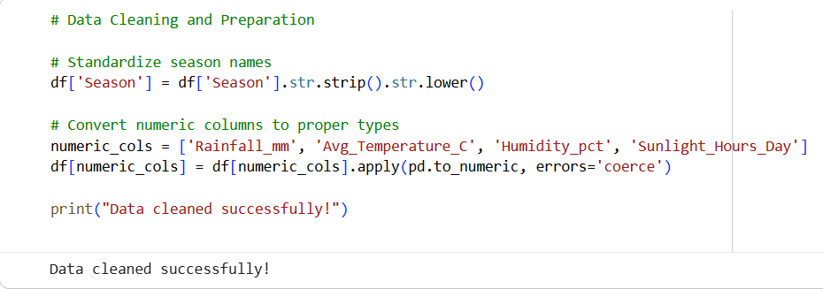
RESULTS

Slide 7
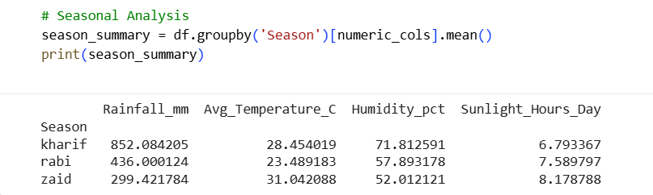
RESULTS
[Add screen shots of your code ]

Slide 8
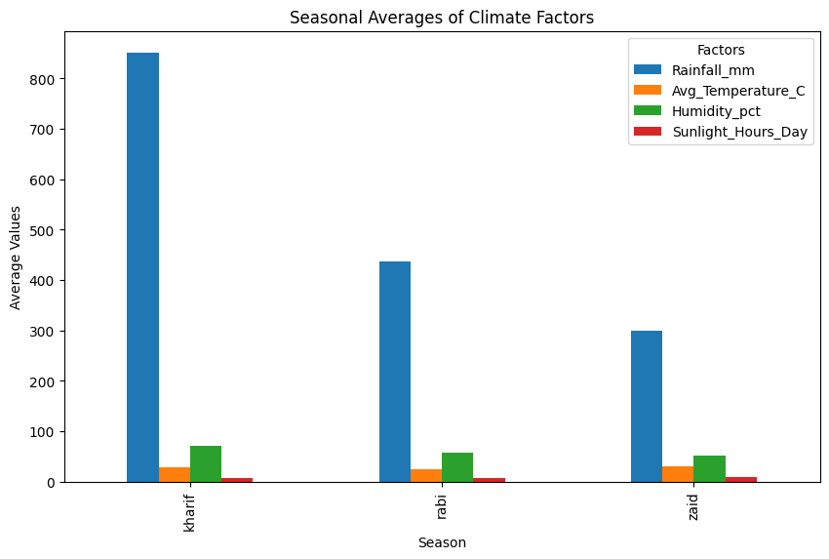
RESULTS
[Add screen shots of your code ]

Slide 9
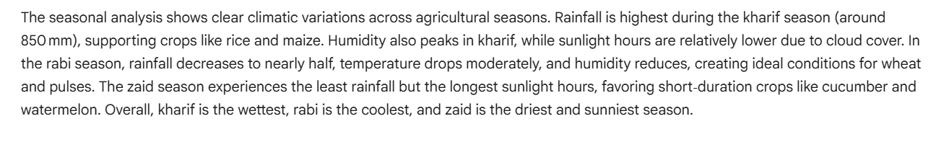
RESULTS
[Add screen shots of your code ]

Slide 10
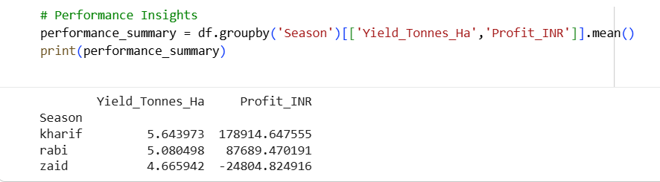
RESULTS
[Add screen shots of your code ]

Slide 11
Future scope
Integration of Economic Data Extend analysis to include cost, yield, and profit trends for deeper financial insights.
Machine Learning Models Use predictive algorithms to forecast crop yields and profitability based on seasonal climate data.
Real‑Time Weather Data Connect with live weather APIs to make dynamic, up‑to‑date agricultural planning possible.
Regional Comparisons Expand dataset to multiple regions to study how seasonal patterns differ geographically.
Decision Support Systems Build dashboards or apps that help farmers choose the right crops and resources for each season.
Sustainability Analysis Evaluate resource usage (water, fertilizers, energy) to promote eco‑friendly farming practices.

Slide 12
GitHub Link
Yash-sononi/Seasonal-Agriculture-Performance-Analysis: Major Project – Seasonal Agriculture Performance Analysis (AICTE VOIS Batch 2026-27)

Slide 13
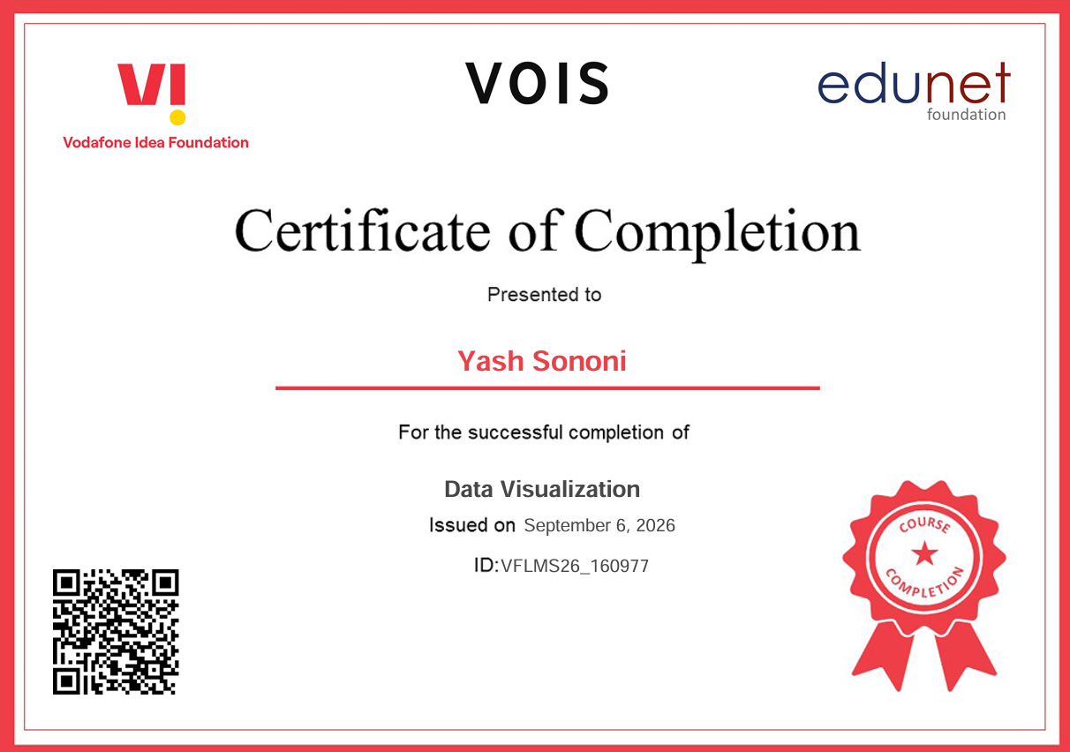
VOIS Course completion certificate - Course name- Data Visualization

Slide 14
Thank you
.
.

